Slide 1
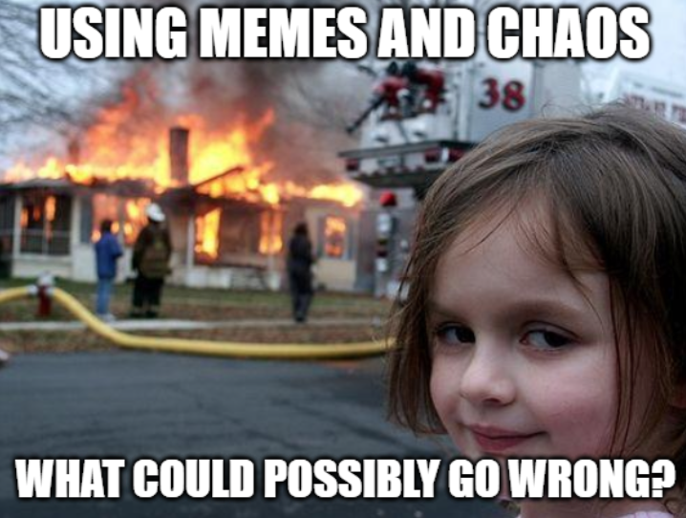
SOC Humor: Using Memes and Chaos to Enhance Detection:
Tyler Moody

Slide 2
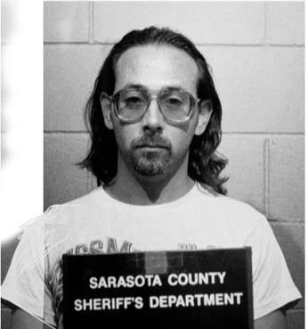
NOT ME!
Whois - Tyler Moody
Notes:
Not Me.

Slide 3
Me!
Over a decade in InfoSec and IT, I’ve evolved from a '90s phone phreaker → a global Security Analyst.
My experience spans Sysadmin roles, ISO Management, and Offensive Security testing.
Currently, I specialize in:
- Emulation
- Purple teaming
- Password auditing
- Building real-world testing frameworks for defensive hardening
- Unconventional defensive methods by offensive
- Hardware exploitation
Notes:
Me! So, this is the most boring part for me. I’m old and got to do a lot of wild stuff in the 90s when a lot technology started emerging. I studied a ton of different subjects in college from Theology, Psych, Law, to Physics, but never got a degree. Wasn’t interested. I went from college into “Philately “– study of rare postage stamps – yep that’s a thing - in my early 20s as the youngest professionally paid philatelist for a swanky global auction company. Ran some IT there and ended up in IT and InfoSec full time around 2012 after the auction firm was bought out. I’ve been lucky to be able to do some pretty cool things. I was a Sys Admin then ISO at a very small org and after it got acquired, I joined a much larger org sort of by accident. I do get to do some cool red team things, just not nearly enough as I’d like. I currently work as one 1 of 3 global security analysts, being the more offensive oriented. They called me a criminal when I they found out I was talking at a Hacker Con. I told them, “yep”! I’ll make sure it’s in my bio. So, humor kind of comes with that.
NEXT SLIDE: Yes, this is my first time submitting and speaking.

Slide 4
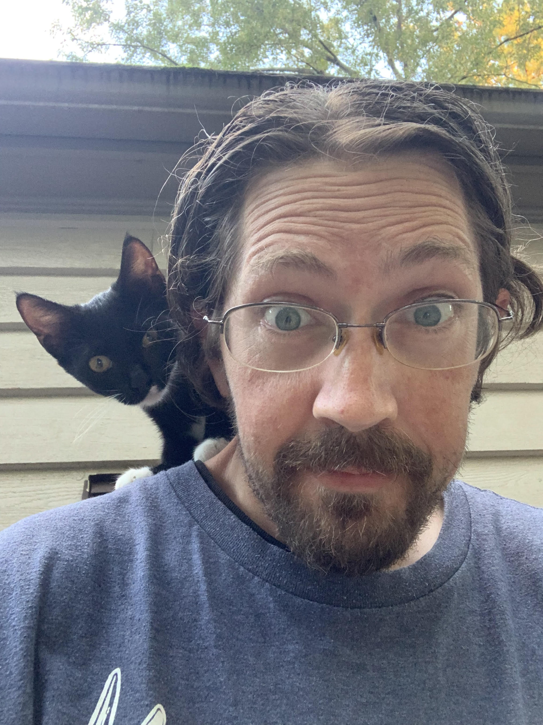
Yep, this is my 1st talk.. Ever.
This WILL be awkward AF …
Notes:
I’ll make sure this is awkward. It’s going to be memes and just awkwardness. This is my cat, Psycho. I raised her as a stray kitten. She’s more human than cat.
Aptly named, she has tried to cut off my breathing while sleeping, several times.

Slide 5
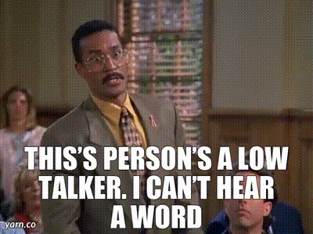
And, I’m a low talker..
Notes:
I’m a low talker. My father and my brother are the same. This is the 1st time I’ve been on a Mic since 5th grade. So hopefully y’all can hear my grating voice. Also, probably a mistake giving me a Mic.
Assuming y’all can hear, let’s get into the talk. It’s really horrible.

Slide 6
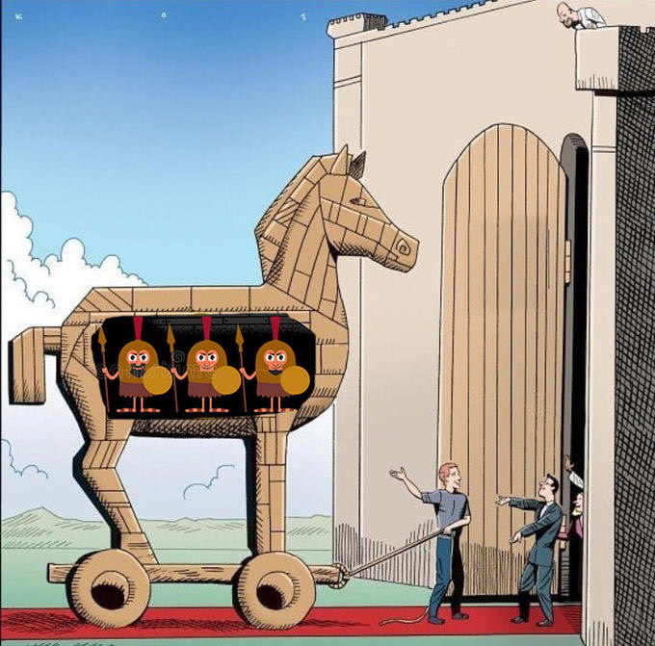
But for the judges, beware of geeks bearing GIFs

Slide 7
Introduction
Alert fatigue is a critical challenge for SOC teams, causing burnout and missed threats.
THIS TALK demonstrates how humor & controlled chaos can:
- Enhance detection capabilities.
- Boost team engagement.
- Break the monotony of routine security operations.
- Breaking down information silos, promoting shared knowledge, and inclusiveness.
Notes:
The last point on being siloed & attempting to disrupt an environment of exclusion. In the past 4 years, I’ve had some bad streaks of luck working for overall great companies, but have landed in some of the most dysfunctional of departments within them.
There is still a lot of gatekeeping, information silo’s, and other tactics of impeding progress, and it really needs to stop. Some of this, has helped me to disrupt that. Much of this has been applied from a different department before I landed in my current one. Covid was in full swing, and I was working with a new team. The project was new and incredibly chaotic. Naturally, moral was bad, but I learned a lot from my bizarre sense of humor.
Part of this, I did in order to try to break it up, and I’ll admit, it’s still a struggle.

Slide 8
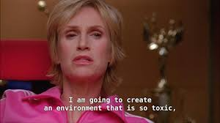
Yep, it also might shake up a toxic environment:
Notes:
If the environment is toxic on top of alert fatigue, it will at least shake things up and start pivoting in the right direction. Sometimes.

Slide 9
'
Tools
Memes as Alerts
- 'Rick Astley ransomware detected'
- Fake 'data exfiltration to the moon'
Tools:
- Automate meme-based alerts
Outcomes:
- Keeps SOC teams engaged and attentive
Notes:
Automating meme alerts is great, if you are able to and have the willingness of your Management/Leadership, but should be done in moderation. It's something I am currently trying to incorporate into an incremental ransomware framework. Also, if you are not testing and tuning alert your before rolling them out to a new SOC, please tread carefully.

Slide 10
Examples and Benefits
Examples:
Creative Testing Scenarios
Examples of humorous attack simulations
- Kitten ransomware
- Space cat meme payloads
Benefits:
Enhances team knowledge
Improves detection rules and workflows
Aids in breaking through information silos and promotes inclusion
Notes:
Eh short examples. With 15 minutes, a live demo on that would have been pressing it.

Slide 11
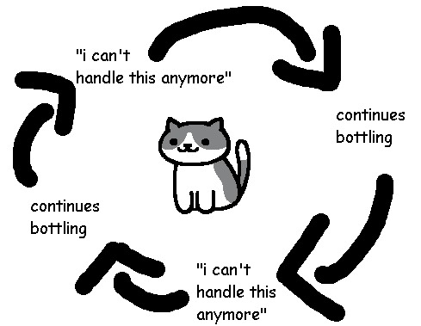
Disruption by : Breaking Down Silos
Notes:
These are also things you can do to break down siloed employee barriers, and disrupt an environment that badly needs disrupting. Honestly though, if it’ a really bad environment, get out asap. Maybe I’m masochistic. Who knows…

Slide 12
How to Use Memes and Chaos to Improve Detection
This is some of what I’ve learned from recently while working with onboarding a Tier 1 SOC team and previous experience.
If onboarding a new team isn’t enough, it was also very chaotic with the volume, deployment of new alerts, and need for tuning.
So, here’s some of what I did for fun…
Notes:
At least in my environment. Things were rolled out fast, and to boot, we already had some issues.
So here is what I do for fun. It somewhat gives your new SOC and detection rules a colonoscopy that they’ll both kinda enjoy.

Slide 13
Chaos
Adding a little chaos to an already chaotic mix.
Make it fun and humorous.
While doing a wide variety of testing new rules and alerts,
I basically started stress testing everything . . . .
Notes:
This sort of naturally came to me because I’m a huge goofball. The 1st time I had a coworker who was just so burned out, came to me at their wits end, I trolled him with nothing George Clooney Nespresso memes and it cheered him up, and he kept on going, giving it his best.

Slide 14

Chaos
But whenever possible, troll all the teams!

Slide 15

Yes, troll them
It often works ..

Slide 16

Like using weird fonts and colors:
Apparently, everyone loves weird fonts and very lightly contrasting colors! Especially when looking at slides ;)
Notes:
So, the remainder of this presentation will be all in school bus yellow color with Comic Sans font. Kidding. - Not really, I actually thought about doing that. And very gradually.. Just to see if anyone noticed by the end.

Slide 17
Disclaimer
Precautions:
- Communicate with management and stakeholders before testing.
- Avoid testing on prod environments or critical systems.
Ensure SOC recognition and reward efforts appropriately.
Know when to ease up, especially during high stress times or during incidents.
Know, recognize, and appreciate team members who may not engage.
Realize that some some memes and humor may trigger trauma in some, so tread lightly.
If you realize things are too toxic and it’s systemic, GTFO! At that point, the
department or company is too far gone, and is likely about to crumble.
Notes:
Disclaimer: Know when to not go too far. My boss is watching this remotely, so I hope he appreciates this disclaimer.

Slide 18
Simple Methods – Password Threat Hunt Shenanigans
Testing poorly configured password threat hunt rules while tuning, and also gauging blind spots or weaknesses within a new team.
Notes:
I started by actually trolling my old teammates editing website html. I found out a lot of them did not know what that was, and that was a real eye opener for me. And you’ll be surprised at the response. Not only did they show an interest in learning how, but many took the initiative to learn themselves.

Slide 19
Simple Methods – Password Threat Hunt Shenanigans
Fake passwords
Excel spreadsheet
Cleartext text files
Encrypted in Base64 /s
Notes:
"Encrytoading"

Slide 20
Simple Methods – Password Threat Hunt Shenanigans
Make a game out of it. Use Steganography, create a custom alert, and if they don’t know stego, they’ll at least learn it trying.
Notes:
Or die trying!

Slide 21
Wait, Wat!??!

Slide 22
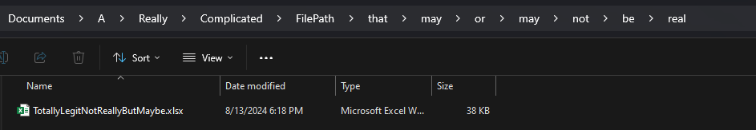
I was bored, so…
I started creating ridiculously long file paths, and created a variety of “dummy” files with fake but somewhat funny usernames and passwords.
Notes:
Hint: If your rules are deployed through XDR (etc.), it’s also a great way to find out if they just went with a scaled back default out of the box system, or a poorly configured alert, rule, or worse – perhaps the installed agent itself.

Slide 23
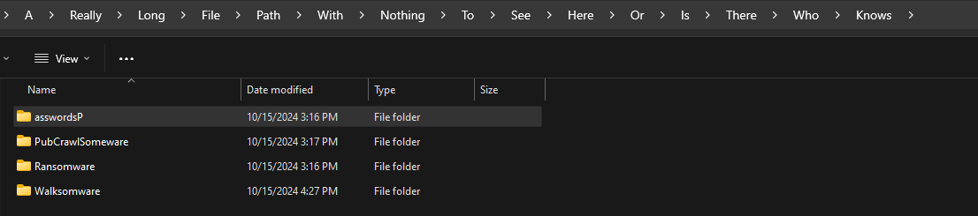
XDR Time Bombs
Such as:
A>Really>Long>File>Path>With>Nothing>To>See>Here>Or>Is>There>Who>Knows
Notes:
XDR, EDR, MDR, Acronym soup. Oddly enough, this one is still undetected. I should probably address this my coworkers who will probably not fix it. Kidding, not really, but maybe.

Slide 24
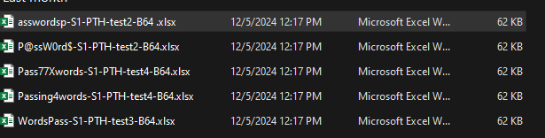
I made the filenames and folders interesting
After testing this, our poor password detection improved.
Notes:
You and your team need to know your environment, it’s critical thresholds on detections. Not only to improve them, but also in the event of any incident, whether large or small, you’ll be able to better understand A: how it happened or B: how to fix or patch it.

Slide 25
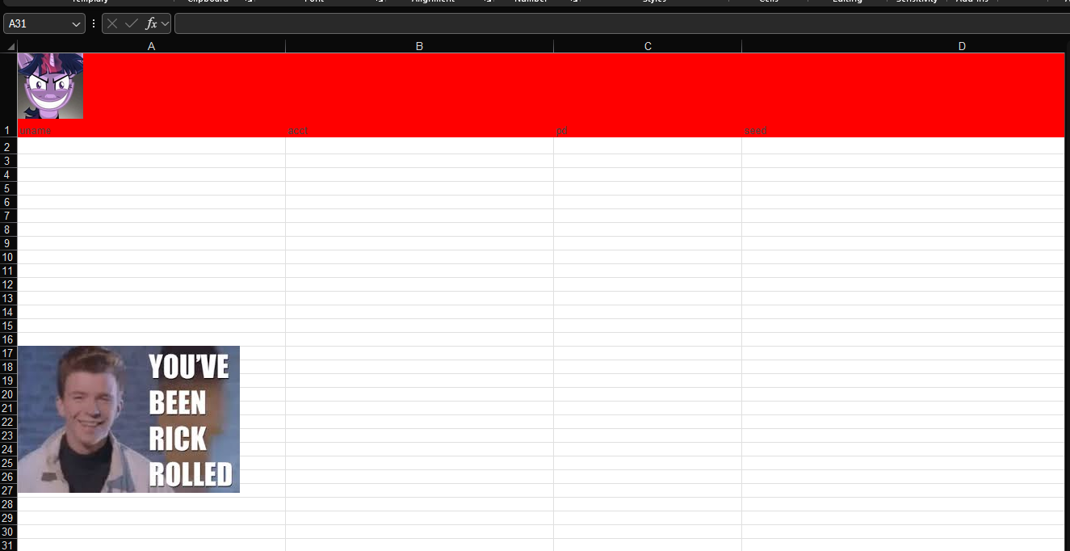
On its surface, it just looked like a false positive
Notes:
Sort of. It does have the usernames & passwords fields so it could be considered a false negative at first, but it is interesting to see what the SOC finds and whether they look further into it.

Slide 26
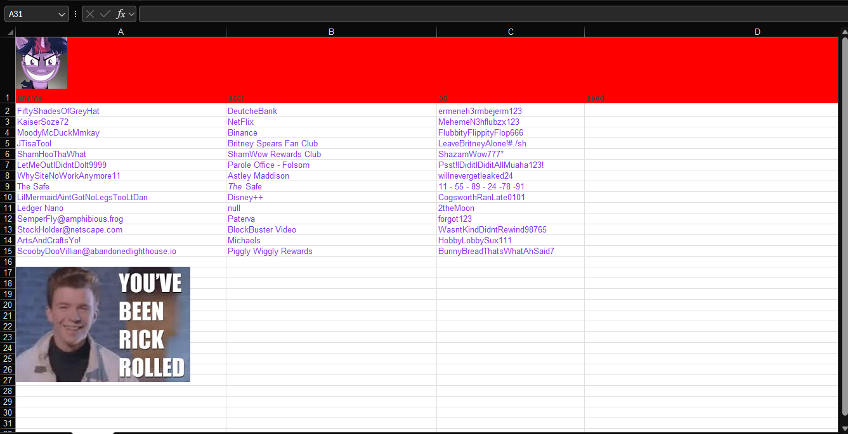
Unless they changed the font color
.
Notes:
-- to cleartext.

Slide 27
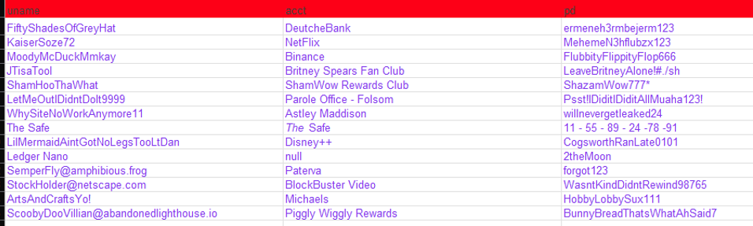
I had fun creating the fake names & passwords

Slide 28
Taking it a step further
In addition to cleartext, use Base64 to encode passwords. And gauge the SOC's experience (or lack thereof) with encoding.
Notes:
You would be surprised how little experience with even simple Base64 encoding many new professionals might have, and in some places, that go well beyond Tier 1, unfortunately.

Slide 29
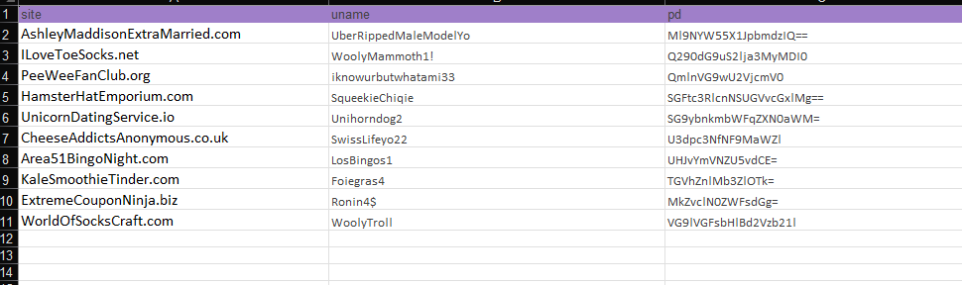
Hopefully only a few think it’s the actual password ;)
Notes:
Yeah you probably could use B64 as a password for some sites, but not all lol.

Slide 30
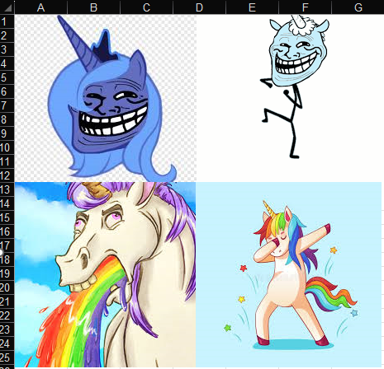
Who could resist adding a sheet just for memes?
Notes:
The barfing Unicorn is my favorite.

Slide 31
Random Fun
Incorporate humor into other alerts.
When they trigger, and other Departments or Management might be involved, humor makes a difference.
Notes:
Testing some alerts may also alert management or even other departments, so making them humorous can make a world of difference.
Instead of annoying them at first and staying annoyed, they might “initially” be annoyed, but they will smile and hopefully laugh. Very much lessening the blow from the standard, dry alert testing.

Slide 32
…Like DLP testing!
Incorporate humor into other alerts.
As they trigger, it makes a difference.
• Highlights gaps in DLP configurations.
• Reinforces the need to test filters with creative, low-risk payloads.
Notes:
For myself, testing custom rules DLP with fake PHI was a lot of fun.

Slide 33
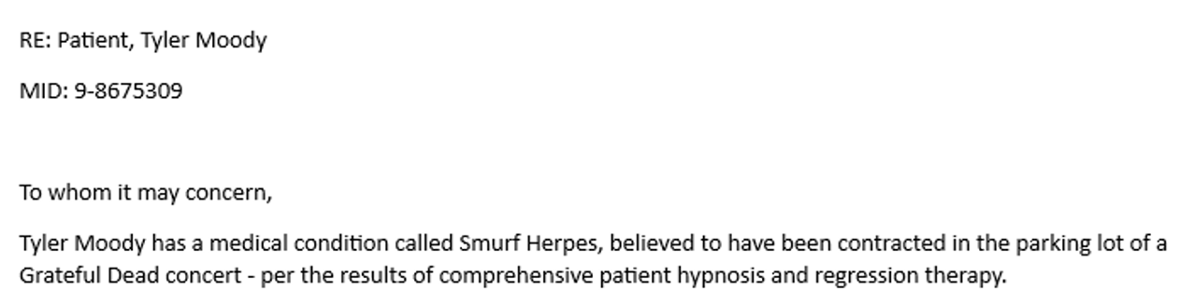
“Smurfitis” DLP Testing Fake PHI
Notes:
This is actually verbatim from 2 different alerts, one with the MID or CIN number to test a RegEx in Cisco IronPort. Using GPT, I had it craft a 500-word email, going into alarmingly bizarre detail, painting myself as suffering from a rare psychological disorder known to the patient (me) as “Smurf Herpes”. IRL, I’ve had worse. Just kidding, not really, but maybe.

Slide 34
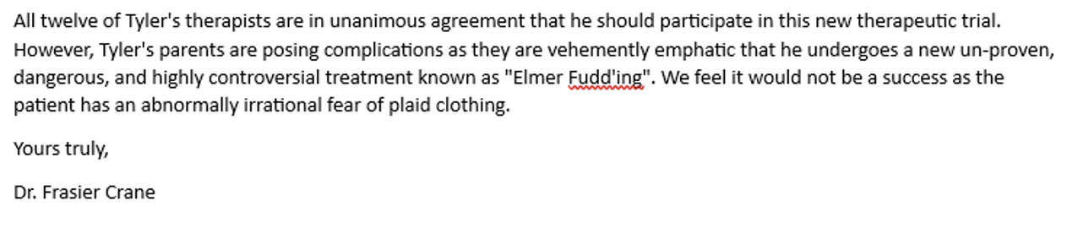
It tripped the PHI alerts
Notes:
It triggered and alerted with the MID and without!

Slide 35
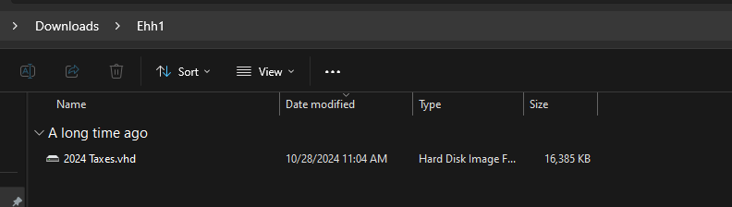
I had fun setting up some bait for a virtual disc detection alert while securing e-mail
Notes:
I tested our email ingress threat defense, then having gotten through & while the detection rule was remediated, I tested it further by letting it sit on my local PC.
I probably could have given the vhd a better name.

Slide 36
Lessons Learned from simple random methods
A:
Threat Detection improved
Alerts response improved
Exposed areas where vendor improvement was needed
B: Makes it fun for already fatigued teams.
C: Allowed me to get a good grasp with a new team of their knowledge and skill-sets.
D: Engages the new team and often incentivizes them to learn new skills.
Overall, the greatest reward is building a culture of engagement!
Notes:
While you are improving your detection, you can also be improving your team and this works really well with new teams who may feel anxious to learn, or grow but are starting to show signs of fatigue. It also fosters a culture of inclusiveness and engagement, which is the best possible outcome that I would hope for.

Slide 37
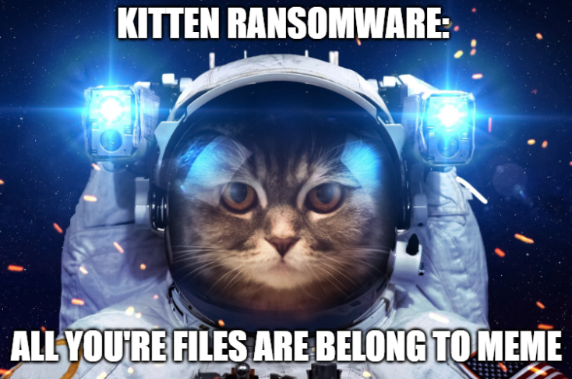
Kicking it up a notch!
When developing a game plan to incrementally test ransomware behavior, I began applying the same tactic.
Notes:
Who doesn’t love kittens and space?

Slide 38
Emulation Methods - Ransomware
Generate thousands of files in directories loaded with space cat memes, because how doesn’t love cats, …and space
Notes:
On a separate project to really stress test our detection and response incrementally, I knew it would be tough for an already stressed team. Adding humor really does make a difference. I’ve yet gotten to the “Nuclear” phase of the testing which will be very chaotic, but I am extremely optimistic in what has already worked.

Slide 39
Emulation Methods - Ransomware
Encrypt these files and rename them with a ".CRYPTO" extension, but also with another extension, like .ELMERFUDDHADASURPRISINGLYHIIQ.

Slide 40
Emulation Methods - Ransomware
Delete the originals and drop a fake "README_DECRYPT.txt" ransom note, but make it obscenely long that reads like a choose your own adventure book with memes.

Slide 41
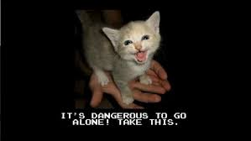
Kitten Meme Ransomware:
Why are all my TPS reports ending in .Meow?
Notes:
There is nothing more fun than to gauge the SOC response, than completely throwing them something wild and new. The downside to this and where you need to be careful is delineating from the abnormal meme testing, so as not to dull or condition the SOC to say “Oh, it’s jus that crazy weird old dude” again. Make sure not to blur the lines - or desensitize them. Always keep it light, random, sporadic and fresh.

Slide 42

Rick Roll Ransomware
Encrypt files and replace them with a ransom note containing lyrics from 'Never Gonna Give You Up'.
Test SOC recognition of unconventional ransom notes.
Notes:
Everyone loves the Rick Astley memes. Yeah they’re way played out, but hey “an oldie, but goodie” . Never give it up.

Slide 43
Lessons Learned
- Creativity can reveal gaps in detection.
- Humor fosters team collaboration and building.
- Incremental testing builds robust SOC workflows.
- Boosts morale.
Notes:
Hey that makes a new acronym. Chic! We need another acronym like I need anther hole in my ass - …dang that’s double digits now.

Slide 44
Conclusion
Laughter & creativity = powerful tools
for improving security operations.

Slide 45
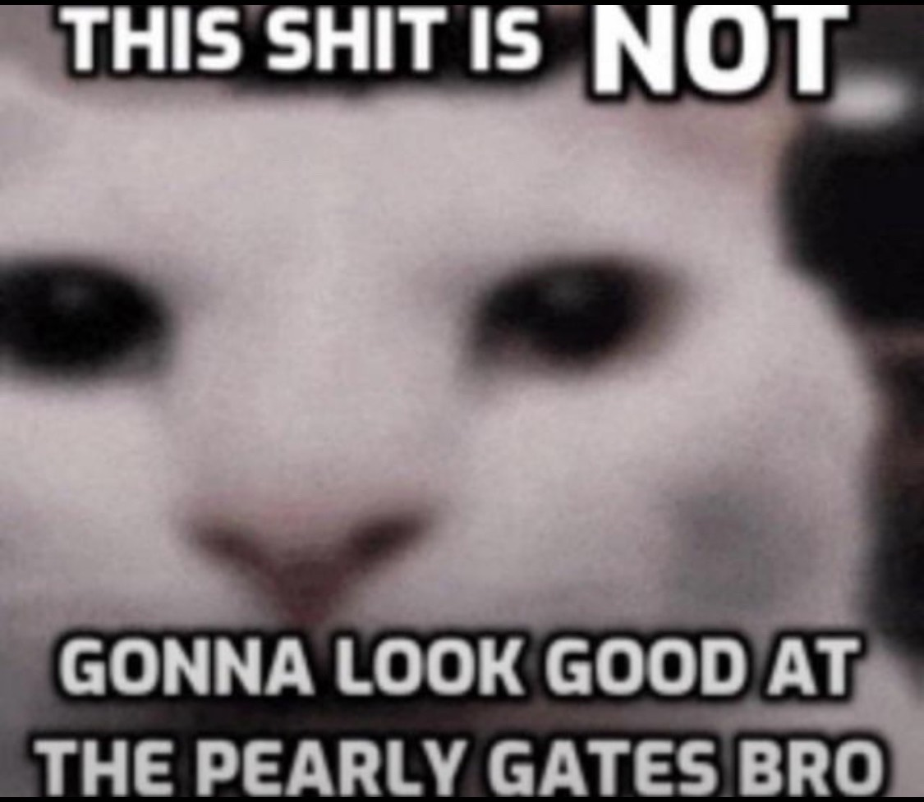
Conclusion
Actionable Steps:
- Experiment with creative testing methods.
- Share findings to foster a culture of engagement.
- Continuously innovate for better security outcomes.

Slide 46
Have FUN with it!
Have fun! This is something I did for fun and because I like to push the boundaries inch-by-inch.
Notes:
I would love to hear how others fare, by testing these methods, and would really like to build out a framework. Currently I’m working on an incremental ransomware emulation framework, and would like to incorporate these methods into it.

Slide 47
Have FUN with it!
Be creative! Think of different ways to test, whether it’s through a different scripting, code, encoding methods or other methods not typically used by ransomware threat actors or groups.

Slide 48
Have FUN with it!
Be innovative!

Slide 49
Have FUN with it!
Reward the SOC! Make it up to them by getting them DoorDash gift cards. Or, if they were able to impressively respond and stay on top of the alerts, make sure this is recognized and give them credit for their efforts.
Notes:
I would love to hear how others fare, by testing these methods, and would really like to build out a framework. Currently I’m working on an incremental ransomware emulation framework, and would like to incorporate these methods into it.

Slide 50
You’re NOT Welcome ;)
ShmooCon and the ShmooGroup: From Bruce and Heidi, to all of the awesome folks I’ve met in labs and Shmoo over the years.
My family, Mom, Dad, and all of my family members, who for the past 15 years have been like “Where’s Tyler?”
My friends, who have inspired me to talk. Joe Schottmann, for inspiring and encouraging me for many years. Kiwi and Sapphire, Ben, for support. My friends at Shmoocon Labs who’ve kept this network working for all you meme fiends for over 20 years.
My coworkers past and present, especially the new Tier 1 SOC who’ve been and continue to deal with more than anyone could imagine.

Slide 51

~ fin ~

Slide 52

Questions!

Slide 53
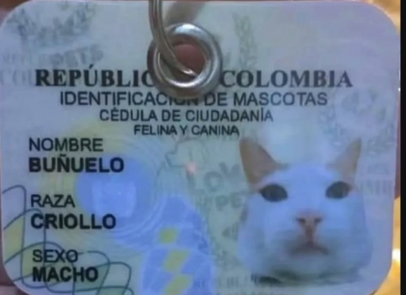
@wireghostx
GitHub:
github.com/WireGhost/Shmoody
LinkedIn:
linkedin.com/in/50ShadesOfGreyHat
Notes:
If no questions, here is my contact info for GitHub & LinkedIn. I’ll be posting the slides to GitHub.

